Slide 1

Psychology of Personality
Warwick in London Summer School 2019
Week 2/ Day 5 (26/7) Dr Liz Blagrove

Slide 2

Aims & Objectives
Understand the rationale for studying the Psychology of Personality, its context & main theoretical approaches
Review the historical roots of (modern) personality theory
Critically evaluate Trait Theory, focusing on including the work of:
Allport
Cattell
Eysenck
Costa & McCrae
Notes:
Start off by giving the theory some context- thinking what psych of personality actually does. What approaches are used. Why it’s important to humans.
We’ll pay some attention to the way this has been explored historically (at least- from the point of modern psych onwards…)
Mostly- we’’ll look at this via the lens of trait theory (main theoretical framework sued today).
And these theorists.
That said…

Slide 3
Aims & Objectives
Assess two (and a half) alternative theoretical stances to the psychology of personality:
Freud
Structure of the personality
Development of the personality
Adler’s individualistic approach
Bandura’s Theory of Social Learning
General learning theory
Components of personality development
The Bobo Doll Studies
Notes:
Because trait theory only gives us one view- and it’s one that is largely silent on dev of personality.
We’ll look t two alternative frameworks, that do address this.
They’re famous perspectives:
Freudian (psychonanalytical/ psychodynamic)
(Adler)
Bandura- theory social learning.

Slide 4

What are Individual Differences?
“No two persons are born exactly alike; but each differs
from the other in natural endowments, one being suited
for one occupation and the other for another…”
Plato, The Republic (360 BCE)
Notes:
Okay- this isn’t a new debate.
Classical philosophy- knowledge (Galen/ Kant)- personality, via bodily humours (balance of these) black bile/yellow bile/phlegm/blood.
Common language.

Slide 5

WHO ARE YOU?

Slide 6

Why study Personality?
Explain motivational basis of behaviour
Ascertain basic nature of human beings
Provide descriptions / categorisations of how individuals behave
Measure personality
Understand personality development
Heritability vs environment
Understand mental illness & abnormal behaviour
– facilitate behaviour change
Notes:
Okay- so if we accept that the ‘quest’ to understand personality is something ingrained in humans.
Why would we want to do this as a psychologists ? (nb psych scientists!)

Slide 7
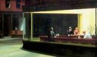
What do we think as Humans?
Implicit personality theories
‘Intuitively based theories of human behaviour that we all construct to help us to understand both others and ourselves’ (Maltby et al., 2013, p3).
Implicit
theories
Behavioural prediction
Observations
The naïve psychologist…
Notes:
If we think about this on a more human level- it becomes obvious that even without the science or the philosophy, this is something that humans do instinctively. They look around at people – observe the behaviour around them and construct predictions on the basis of these observations.
Predictability, understanding.
People watching- the idea of the naïve psychologist.

Slide 8
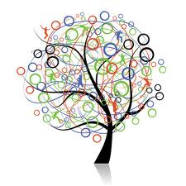
Does this work?
Problems with implicit theories
Evidence base
Casual, non-random observation
Confirmatory bias
Notes:
The problem with this is that without a systematic, scientific way of collecting/analysing the data – we have a flawed process.
We will be observing people around us- who may be more likely to share certain characteristics- views- etc.
Self-limiting sample.
We’ll be taking cursory ‘snapshots of behaviour’- without the proper controls for understanding them properly, or the means to measure context.
Confirmatory bias- issue for everyone, regardless of knowledge. (Bit of a buzzword at the moment!)

Slide 9
Personality Defined
‘…a dynamic organisation, inside the person, of psychophysical systems that create the person’s characteristic patterns of behaviour, thoughts and feelings.’ (Allport, 1961, p.11)
Continual adjustment
Mind and body interaction
Stability
Centrality of influence
NB arrows to illustrate dynamism of model only- no directionality should be inferred!
Notes:
This is one that I particularly like. – please note the arrows are there to show everything links to everything!
Comes from Allport- widely credited as one of the key figures in personality theory.
4 things I’d like you to note here:
Dynamic internal- changing/adjusting
Psychophysical- so mind (brain) and body
But shows some stability…so these are identifiable as typical
Importance- in a number of domains. Behaviour (actions)- thoughts- feelings…

Slide 10

Approaches to studying Personality
Idiographic
Focus on the individual
Describe personality variables within that individual
Each individual has a unique personality structure (infinite)
Notes:
Two main approaches to studying personality theory-
Idiographic/nomothetic.
Overarching framework for the rest of it- spend next few slides looking at these two approaches (and comparing their approaches).

Slide 11
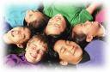
Approaches to studying Personality
Nomothetic
Focus on finite number of personality variables
Occurring consistently across groups of variables
Individual is located within this set of variables
Notes:
Note_ combination of these approaches (Carver & Scheier)- finite number of variables, infinite arrangement.

Slide 12
Comparison of Idiographic and Nomothetic Approaches
RESEARCH
STRATEGY
GOAL
IDIOGRAPHIC
NOMOTHETIC
Emphasizes uniqueness of the individual
Focuses on similarities between groups. Unique combinations of traits
Identify basic
“structure”. Minimum number of traits to describe universal personality
To develop in-depth understanding of individual
(Adapted from Maltby, et al., 2013, p8, Figure 1.2)
Notes:
Aims/goals

Slide 13
Comparison of Idiographic and Nomothetic Approaches
IDIOGRAPHIC
NOMOTHETIC
RESEARCH
METHODS
DATA
COLLECTION
Qualitative.
Use of case studies. Some cross-study comparison possible
Quantitative.
Explore structure
Produce measures
Examine r’ships between variables
Diary studies, interviews, narratives, therapy session data
Self-report
personality questionnaires
(Adapted from Maltby, et al., 2013, p8, Figure 1.2)
Notes:
Methods!

Slide 14
Comparison of Idiographic and Nomothetic Approaches
ADVANTAGES
DISADVANTAGES
IDIOGRAPHIC
NOMOTHETIC
Depth of understanding
General principles
Predictive value
Superficial understanding of individuals. Detailed training needed
Difficulty in generalization
(Adapted from Maltby, et al., 2013, p8, Figure 1.2)
Notes:
Advs vs disadvs

Slide 15

Defining Personality Traits
A trait is…
‘…a dimension of personality used to
categorise people according to the
degree to which they manifest a
particular characteristic.’ (Burger,1997).
‘…conditional probability of a category of behaviours in a category of contexts’. (Mischel, 1999).
Notes:
Move onto the main focus for today’s lecture- trait theory.
Picture- early NON SCIENTIFIC attempt at trait theory…
Two definitions.
Categorization- extent of trait
Probability of behaviour in certain situation.s

Slide 16
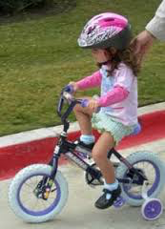
Defining Personality Traits
Assumptions
Stable over time
Stable across context
Nomothetic approach
Notes:
A couple of things that define trait theory….before we move on.
Stability across time
Stability across context
Nomothetic approach.

Slide 17

History of the Trait Approach
The Lexical Hypothesis (Galton, 1884)
Allport & Odbert (1936)
18,000 words identified
4,500 describing personality traits
Notes:
Trait theory history- runs parallel to history of modern psych itself.
Starting19 century- Francis Galton (Who? Where? Why?)
Idea- that important words in our language relevant to our conceptualization of personality-single terms, mainly referring to traits (synonyms, more frequently used+ more important).
Classic study- 1936- give an idea of scale (restricted to lists/ cross checking)

Slide 18
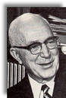
The Structure of Personality (Allport, 1961)
Personality traits
Cardinal traits single dominating trait e.g., competitiveness
Central traits 5-10 best descriptors
Secondary traits preference rather than core
Notes:
Allport- made many other contributions to trait theory (in fact, first to make distinction between nomothetic/idiographic).
Here- main contribution was in defining a hierarchy of personality traits- based on explanatory power (in terms of understanding personality and behaviour as a whole)

Slide 19
Distinguishing Trait Types (Cattell, 1965)
Environmental-Mold Traits
Constitutional Traits
Ability Traits
Types of Traits
Dynamic
Traits
Unique Traits
Common Traits
Temperament
Traits
Notes:
Cattell developed this further, with 7 different types of traits.
These reflected a particularly broad view of how our personality can affect our behaviour.
Constitutional- genetic influences (heritable)- pervade personality
Environmental-mold- nurture bit!
Ability/ Dynamic/Temperament traits- all related to task performance
Ability- how well you deal with a given situation/ how well you reach your goal (e.g., intelligence)
Dynamics-motivate and energize our behaviour (attitudes, sentiments- ergs- innate drives)
Temperament- style in which you pursue your goal ( laidback, anxious, irritable)
Common traits- shared by many people ( e.g., intelligence. Sociability)
Unique traits- rare- specific to individuals ( e.g., specialized interests).

Slide 20
Using Cattell’s Trait Distinctions
Surface traits
Collections of trait descriptors that cluster together
in many individuals and situations
Source traits
Responsible for the observed variation in surface traits
Represent underlying structure of personality
SourceTraits
Extraversion
Surface Traits
Sociable
Carefree
Hopeful
Contented
Notes:
So besides contributing to our understanding of different trait types- Cattell also highlighted the structure of personality.
Using factor analysis ( a form of statistical analysis, where individual variables are analysed to see how they cluster together).
Surface traits- characteristics that we see in many situations/people- responsible for observable behaviour
Source traits- underlying trait that accounts for surface trait. Underlying building blocks of personality.
Example here.

Slide 21
16 Major Source Factors 16PF Questionnaire (Cattell, Eber & Tatsuoka, 1970)
Factor ID | Popular Name (Technical Name)
Factor A | Outgoing/Reserved (Affectothymia/Schizothymia)
Factor B | Intelligence
Factor C | Stable/Emotional (High ego strength/Low ego strength)
Factor E | Assertive/Humble (Dominance/Submissiveness)
Factor F | Happy-go-lucky/Sober (Surgency/Desurgency)
Factor G | Conscientious/Expedient (High superego/Low superego)
Factor H | Venturesome/Shy (Parmia/Threctia)
Factor I | Tender-minded/Tough-minded (Premsia/Harria)
Notes:
As part of his work, Cattell advanced our understanding of what those traits might actually be.
Using the same stats techniques – he reanalysed Allports’ work from the 1930s (4k+ traits)
Got it down to 47 surface traits, explainable by 16 sources traits.
Included these here for your interest- not any time on them.
Listed hierarchically, by explanatory importance
3 names- factor ID, everyday name – technical name- WHY?

Slide 22
16 Major Source Factors (Continued)
Factor ID | Popular Name (Technical Name)
Factor L | Suspicious/Trusting (Protension/Alaxia)
Factor M | Imaginative/Practical (Autia/Praxernia)
Factor N | Shrewd/Forthright (Shrewdness/Artlessness)
Factor O | Apprehensive/Placid (Guilt-proneness/Assurance)
Factor Q₁ | Experimenting/Conservative (Radicalism/Conservatism)
Factor Q₂ | Self-sufficiency/Group-tied (Self-sufficiency/Group adherence)
Factor Q₃ | Controlled/Casual (High self-concept/Low integration)
Factor Q₄ | Tense/Relaxed (High ergic tension/Low ergic tension)

Slide 23
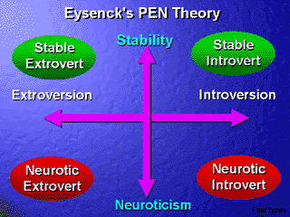
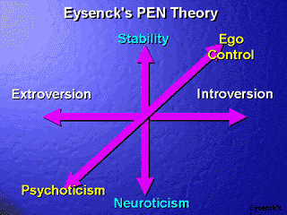
Three Factor Model
Based originally on 2 biologically-based continuum factors
Eysenck Personality Inventory (EPI: Eysenck & Eysenck, 1964)
Neuroticism-Stability
Extraversion- Introversion
Eysenck Personality Questionnaire (EPQ: Eysenck and Eysenck, 1975)
Psychoticism-Socialization added
Psychometrics & research base
Lie scale included
Notes:
Based on biological work- how individuals brain body interaction- manage/seek physiological arousal (e.g., an extrovert has a low level- seeks more).
Idea here though is that each individual will fall somewhere along the continuum for each of these traits.
Extravert- introvert
Neurotic vs emotionally stable (look at more detail in a couple of slides).
However, neuroticism can be defined anxiety/ negative emotion/ instablility.
Psychoticism – neurotiics- without the fear
(Methods)
Lie scale added.

Slide 24

EPI vs EPQ
Notes:
Best way to evaluate these is by trying them –EPI and the EPQ here.
5-10 questions from each. Don’t think too deeply- or worry, won’t be sharing responses.
Brief evaluation a sa group afterwards.

Slide 25
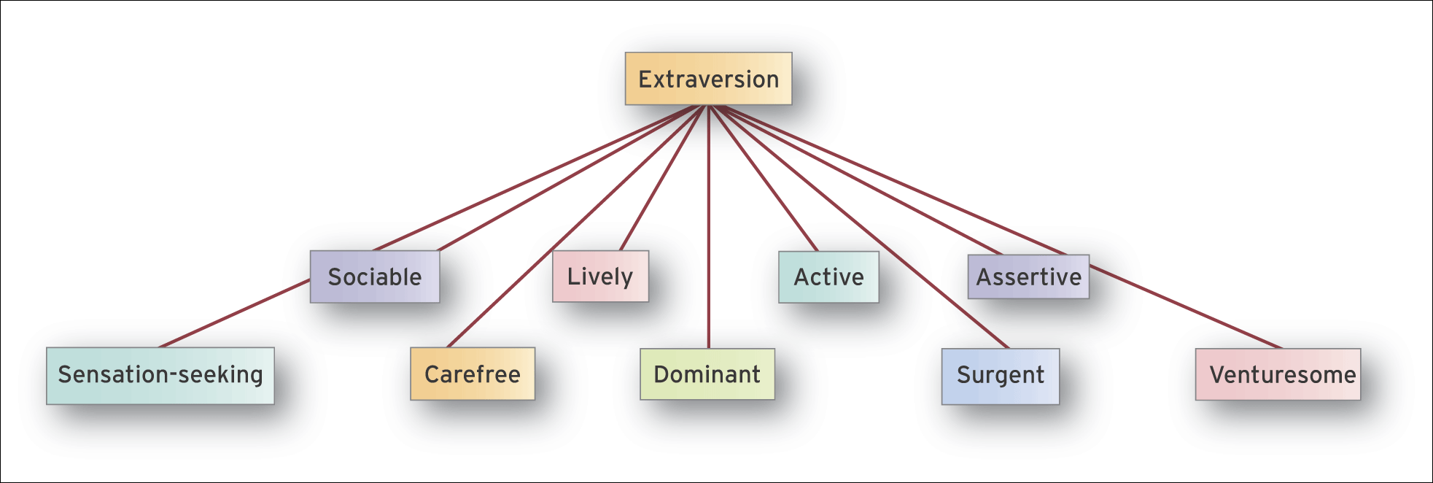
Extraversion Traits
Introversion
Extraversion
(Based on Eysenck and Eysenck, 1985a, see also Maltby et al., 2013, p. 164)
Notes:
Let’s look more closely at these three factors…so testing by EPQ
Remember the idea of the continuum- all present somewhere along this. ± at both extrema.
Surgent+ resourceful. Enterprising.
What do you think?

Slide 26
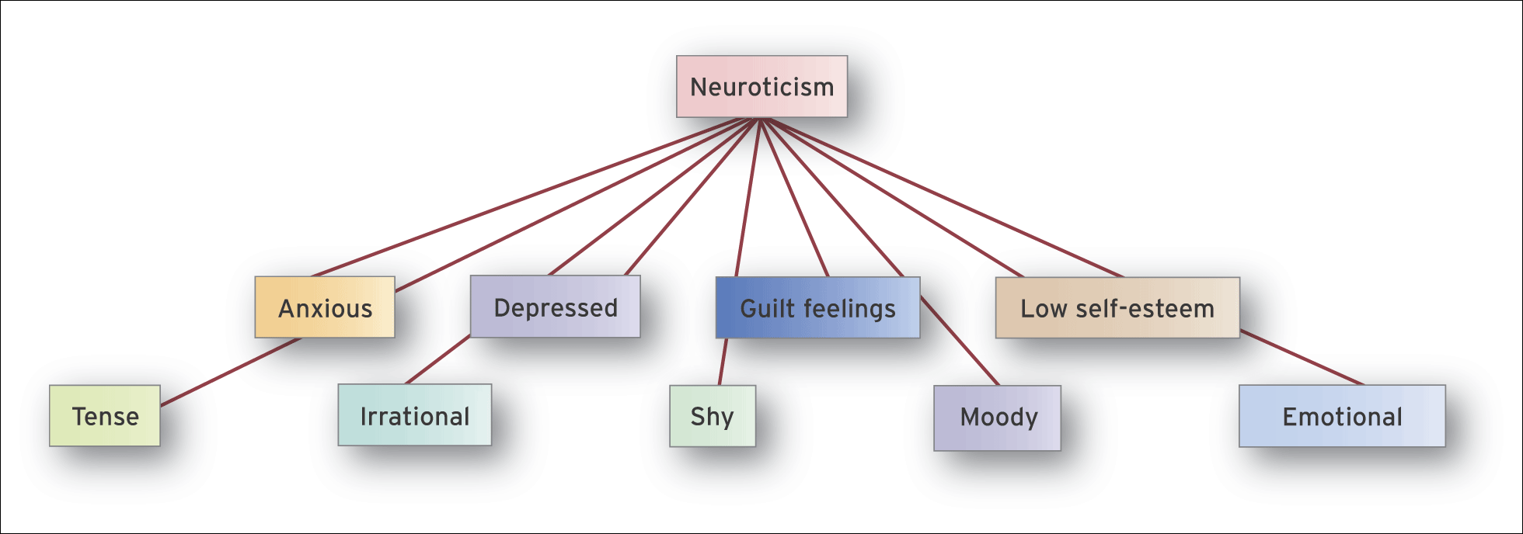
Neuroticism Traits
Emotionally Unstable
Emotionally Stable
(Based on Eysenck and Eysenck, 1985a, see also Maltby et al., 2013, p. 165)
Notes:
Neuroticism here…fewer positives.
What do we think about emotionality?

Slide 27
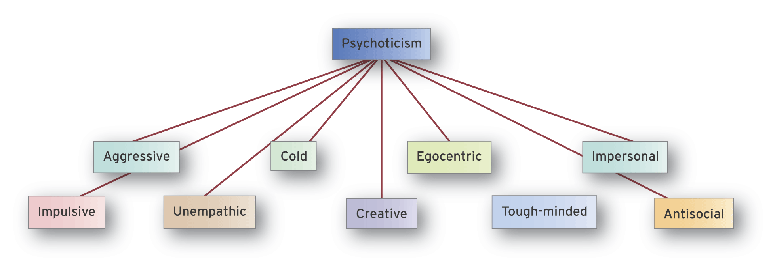
Psychoticism Traits
Empathy?
Socialization?
Ego control?
Psychotic
(Based on Eysenck and Eysenck, 1985a, see also Maltby et al., 2013, p. 165)
Notes:
Lastly, remember how psychoticism emerged as a trait.
Positives? Negative?
(Important to note that similar terminology to ‘psychotic’ in clinical psych or ‘Psychopathy’ in trait theory- but slightly different conceptualization)

Slide 28
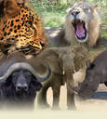
Evidence for the Five-Factor Model
The Lexical Approach
Re-analyses of Cattell’s 16F solution show only 5 factors
Fiske, 1949
Tupes & Christal, 1961;1992
Norman, 1963
Digman & Takemoto-Chock, 1981
Goldberg, 1981;1990
Costa and McCrae (1985;1989;1992;1997)
Data-driven factor analysis evidence (2PQs)
Notes:
Right- so where does this get us? 16 too many? 3 too few? Reductionist? Or overcomplex?
Rationale for including citations…
Reanalysis (some examples) consistently show 5 factors. What’s become known as the big five. FFM etc.
The version of this we’re going to focus on is Costa & McCrae-
2 personality questionnaires- thousands of participants. Factor analysis

Slide 29
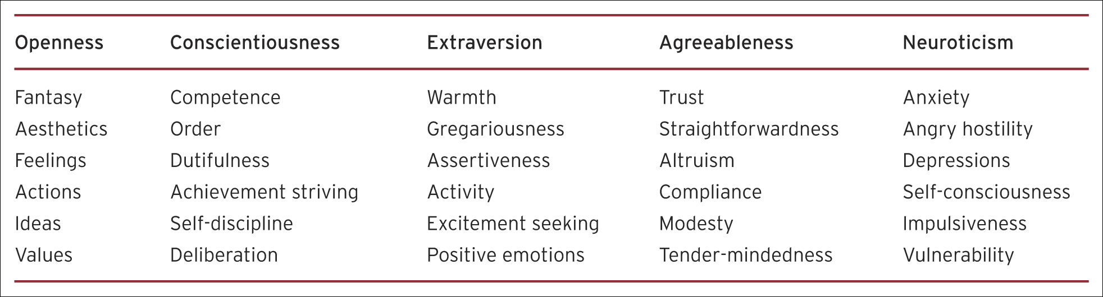
Subordinate Traits (or constituent facets) of the Big Five
Maltby et al. (2013, p. 169; based on Costa and McCrae, 1985)
NEO-PI-R (Costa & McCrae, 1992)
NEO-PI-3
NEO- FFI (1992); TIPI (Gosling, Rentfrew & Swann, 2003)

Slide 30
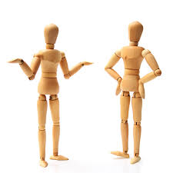
So where does that leave us?
(Some alternative views…)
Notes:
So where does this leave us? What are your thoughts about thus?

Slide 31
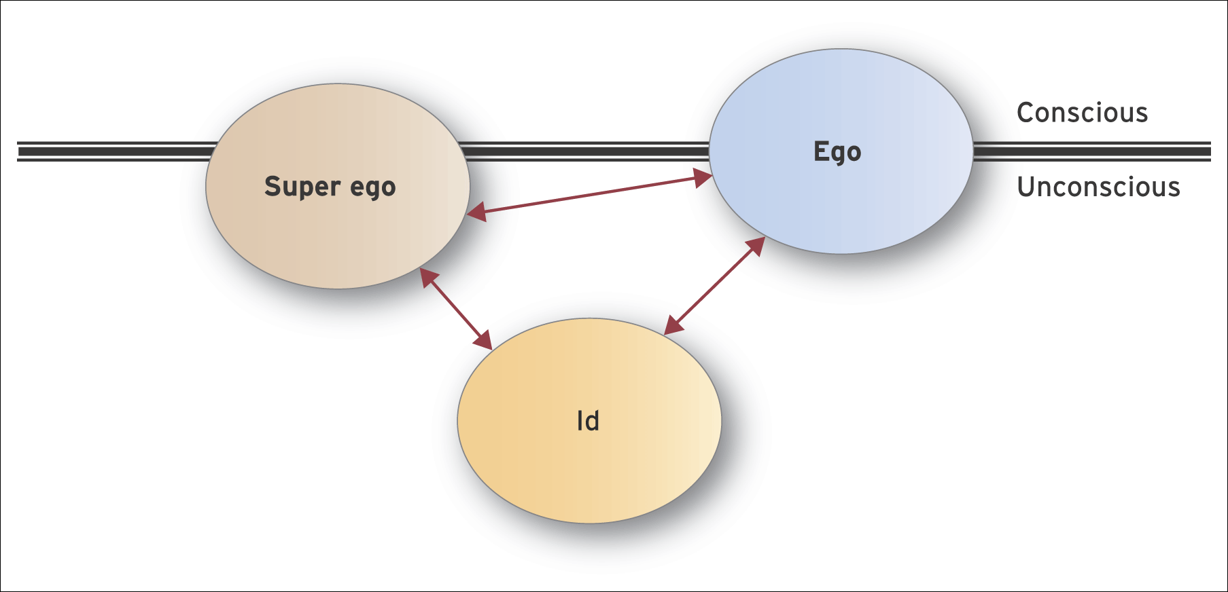
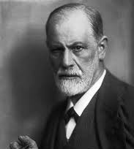
Freud’s Structure of Human Personality
Maltby et al. (2013), p 25
Notes:
So let’s start off with an alternative view to the trait approach.
Important- influential- but not scientific (no way to test his theory, his predictions!). Public perception of psychology
3 components of personality- see how they relate to the divide between conscious/ unconscious processes. Interrelation between the aspects.

Slide 32
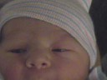
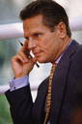
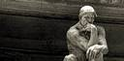
Raw, uninhibited instinctual energy
Source of impulses and mental energy
Also drives for basic survival needs, and sex, aggression and self-destruction
Id
Planning, thinking and organizing
Mediator between child and world
Reality principle and secondary processes
→ social factors
Ego
Conscience (internalized parental attitudes etc).
Acts in opposition to the Id.
Also regulation of the ego…..
Superego
Notes:
IN more detail- this is what Freud proposes each of these components to cover. Almost child, adult, parent… basis for approaches like transactional analysis.

Slide 33
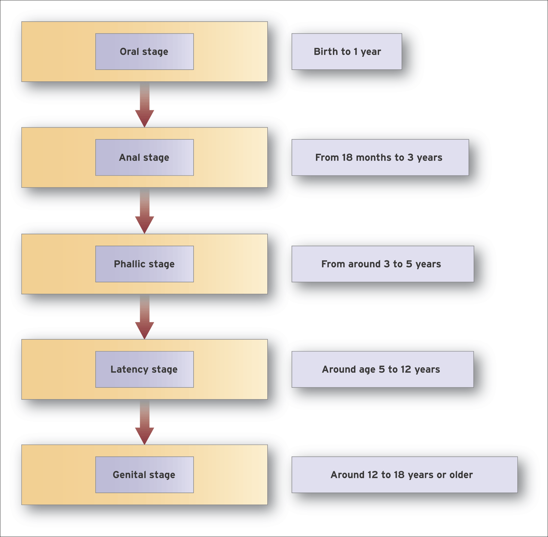
Freud’s Theory of Psychosexual Development
Maltby et al. (2013), p.27
Notes:
What I like about Freud’s model is is suggests how personality develops.
It’s deterministic though… and hugely contentious (this model is based on the idea of infantile sexuality- role of parents as sexual rivals or objects).
Each stage is fixed- some variability in time scale.
Fixation on each stimulus. Sufficient stimulation to progress on to next stage
Note latency phase.

Slide 34
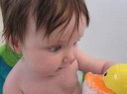

According to Freud….What can go wrong?
Psychosexual Development
Fixation
Can occur at any stage…
Internal resistance to transferring libidinal energy to new objects
Personality Components
Conflicting demands of Id, Ego and Superego
Intrapersonal anxiety
Can occur at any stage…
Latency phase → defence mechanisms
Notes:
So, two ways this can ‘go wrong’- and subsequently have an effect on personality!

Slide 35
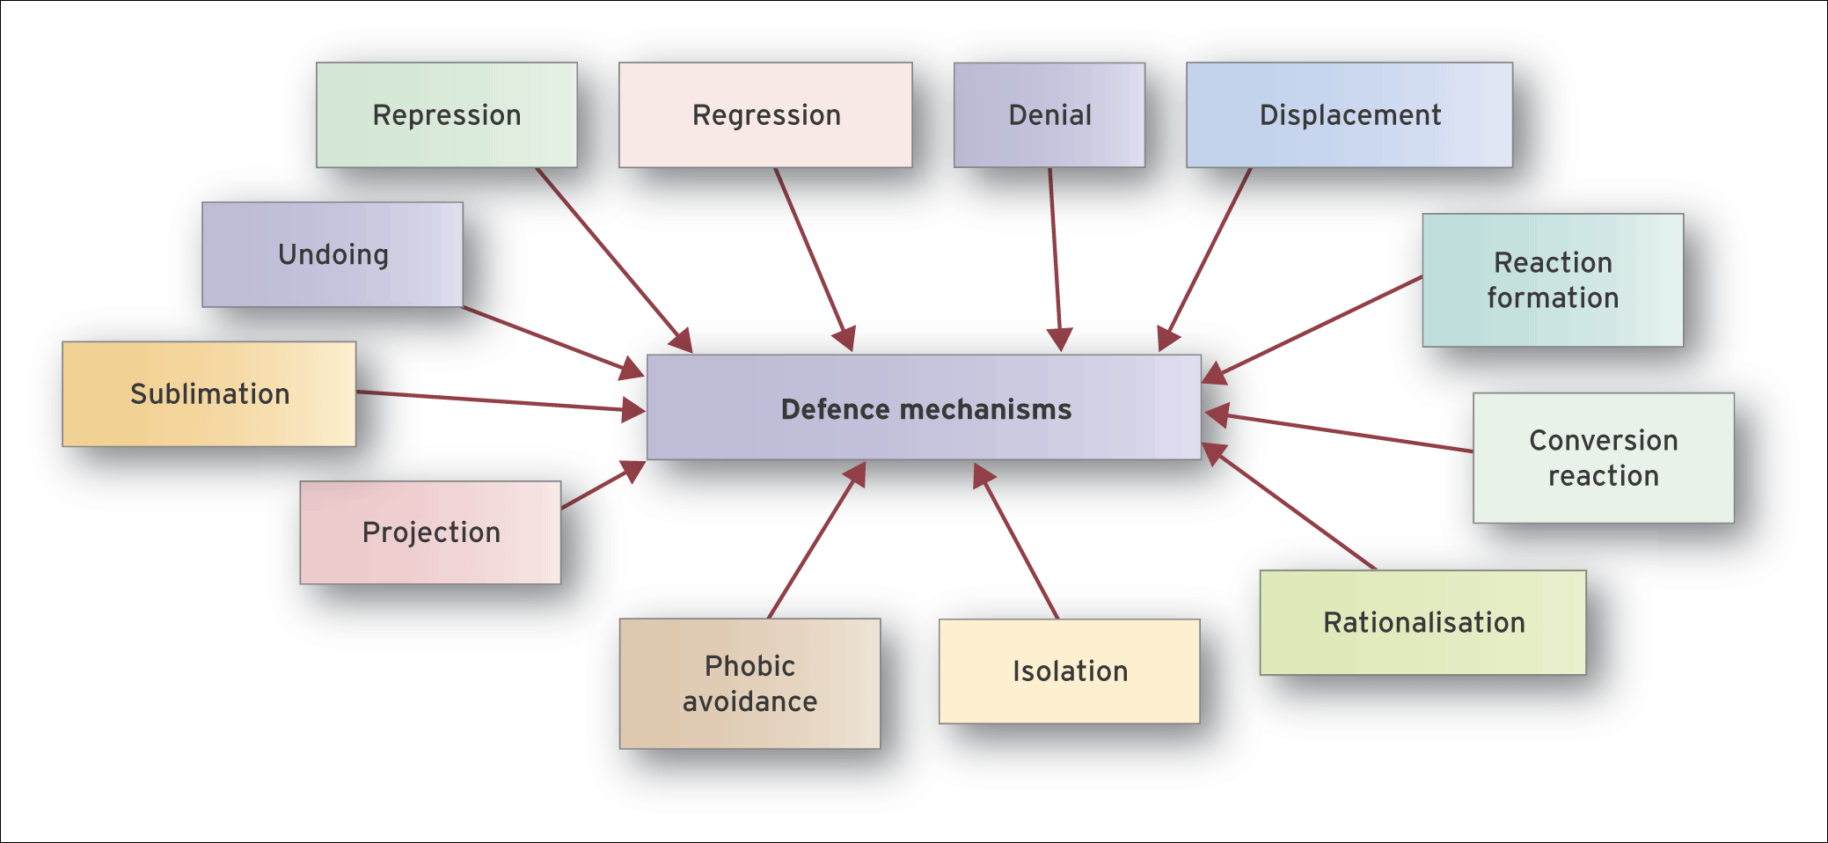
Defence Mechanisms
Maltby et al. (2013), p30
Part of our culture…?
Notes:
Here for interest. Different types of defence mechanisms that can emerge during the latency period- as a means of keeping repressed material repressed±
How much of this is common knowledge? Used everyday contexts?

Slide 36
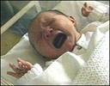
Adler’s Individual Psychology- An Overview
Inferiority feelings
Experienced from birth – helpless infant
Strive for mastery to fulfil potential
Birth order
Unique treatment of each child
Individual experience of the family
‘Style of life’ developed from family experience (and interpretation of FE ; Adler, 1958)
When inferiority is not compensated for
Neurotic personality develops
Notes:
I think it’s wrth mentioning Adler here- originally a student of Freud- whose works diverges because of professional differences with Freud (mainly on psychosexaual dev and role of parents)
Adler is part of the neofreudian school of psych.
Focuses on the individual, their experiences from birth
Experience of the family- and of the family!

Slide 37


Development of Personality Types
Teleology
Contrast with deterministic approach
Overarching goal of superiority/mastery
Driving achievement and maximizing potential
Goal is fictitious → never achievable!
Basic Concerns
Three generalized concerns; Work, Friendship, Love …
Role of Parents
Provide accurate conceptualization(s)
Introduction to “social life”
Interactional relationships
“Equality”- both parents have crucial roles
Notes:
Some other points that Adler uses to differentiate himself from Freud….

Slide 38
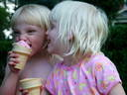

Effects of Birth Order
Eldest
Child: ‘dethroned monarch’, understands status
Adult: conservative, respect authority, maintains status quo, intellectual attainment
Second
Child: competitive, reacts to behaviour of older sibling
Adult: demanding of themselves, unrealistic goals
Youngest
Child: babied by family, attention and pampering
Adult: high dependency, desire to excel, need for praise
Only
Child: without ‘rivals;, likely to be pampered (by mother)
Adult: need for approval, difficulty with criticism/ dislike,
intellectually able and high achieving
Notes:
This experience Family of child, child of family- most popular idea from Adler.
Birth order- Ask group.

Slide 39
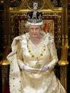



Adlerian Personality Types
- lacks social interest
- intense striving for power
- emotionally manipulative
- possibly result of addiction, delinquency or domineering adulthood
- lacks confidence
- head in sand approach
- deny problems exist
- deny accountability
- blame others
Avoiding Type
Ruling Type
- faces life confidently
- positive social interest
- prepared to co-operate
- contribution to welfare of others; healthy approach
- passive
- little problem-solving
- use personal charm
- parasitic state
- unhealthy
Getting Type
Socially Useful Type
Notes:
Just for interest, you can see here the culmination of Adler’s theory, where he proposes 4 personality types…. Only 1 is positive!

Slide 40
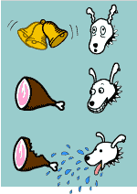
Classical Conditioning: Pavlov (1906, 1927,1928)
Unconditioned stimulus (UCS) Unconditioned response (UCR)
food salivation
Conditioned stimulus (CS)
Metronome
reinforced by
Unconditioned stimulus (UCS) Unconditioned response (UCR)
food salivation
Conditioned stimulus (CS) Conditioned response (CR)
metronome salivation
Operant Conditioning: Skinner (1948, 1971,1972, 1976)
Consequences of behaviour important:
Reinforcement
Reward
Punishment
Friendly person has been reinforced for being friendly (& visa versa)
Notes:
Final contrasting model- we’ll briefly look at learning approaches to personality. Step back to the basics first!
Classical conditioning (also known as Pavlovian or respondent conditioning) refers to a learning procedure in which a biologically potent stimulus (e.g. food) is paired with a previously neutral stimulus (e.g. a bell).
Operant conditioning (also called "instrumental conditioning") is a type of learning in which (a) the strength of a behavior is modified by the behavior's consequences, such as reward or punishment, and (b) the behavior is controlled by antecedents called "discriminative stimuli" which come to signal those consequences ...
Skinner- even more radical than Pavlov, suggesting that everything in behaviour could be explained through S-R- and that examining any parts of the process ‘in the black box’ of the brain – unscientific
Thus- in personality terms. X trait is present because it has been reinforced somehow.

Slide 41
Social Learning Theory (Bandura, 1978/1989)
Do internal or external forces control our behaviour?
Interacting factors in reciprocal determinism
Person Factors
Environmental Factors
Behavioural Factors
Notes:
This is an extreme approach.
Radical behaviourism only acknowledges the importance of the stimulus and the response.
Bandura’s approach looks at the relative contribution of internal and external factors.
Reciprocal determinism- everything affects everything else!
Bandura…
Person factors: cognitions, emotions, biological factors that contribute to inner state
Behavioural Factors: Behavioural input to feelings and cognitions about something (influencing possible response).
Environmental factors: environmental input… as above.

Slide 42
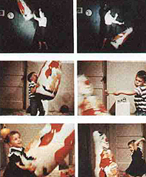
Personality Development & Social Learning Theory
Q: How do we learn to become “us” & to behave as we do?
Observational learning and modelling
(Bandura’s Bobo Doll Study, 1963)
Simple, similar, type of behaviour
Attributes of the observer
- Consequences of imitation
Notes:
Most famously, he was responsible for the Bobo doll studies… in the 1960s
Idea of learning to become us.
Principle of observational learning.
Nursery school kids- american university
Observe behaviour (difference formats- different models, proximate/remote) over 2/3 more aggressive actions, replicating the b’iour.
What makes the behaviour more likely to be replicated?
Similarity or relatability of observer- consequences.

Slide 43
Reading
Required Reading: Chapter 13 in Psychological Science (course text)
To be completed by (please): Thursday 2/8
Optional Task: Consider the two different approaches to understanding personality. Which one do you think is most appropriate- why? Do you favour a combination of both- why? (Suggested completion- sometime before the exam! ☺)

Slide 44

Further Reading (Trait Theory)
Goldberg, L. (1993). The structure of phenotypic
personality traits. American Psychologist, 48, 26-34.
McCrae, R., Costa, P., Ostendorf, F., Angleitner, A., Hrebickova,
M., Avia, M., Sanz, J, Sanchez-Bernados, M., Kusdil, M.,
Woodfield, R., Saunders, P., & Smith, P. (2000). Nature over
nurture: Temperament, personality, and life span development,
Journal of Personality and Social Psychology, 78, 173-186.
Paunonen, S. (2003). Big five factors of personality and replicated
predictions of behaviour. Journal of Personality and Social
Psychology, 84, 411–424.

Slide 45

Further Reading (Freud/Neofreudian Theory)
Adler, A. (1992). What life could mean to you. Oxford: Oneworld.
Horney, K. (1950). Neurosis and human growth. London: Norton.
Silverman, L. (1976). Psychoanalytic theory: The reports of my death are greatly exaggerated. American Psychologist, 31, 621-637.
Storr, A. (1983). Jung: Selected writings. London: Fontana.

Slide 46
Further Reading (Learning & Humanistic Approaches)
Bandura, A. (1974). Behaviour theory and models of man. American Psychologist, 29, 859-869.
Casemore, R. (2011). Person-centred counselling
in a nutshell. 2nd edn. Sage: London.
Jankowicz, A. (1987). Whatever became of George Kelly? Applications and implications. American Psychologist, 42,481-487.
Mearns, D. (2003). Developing person-centred counselling. 2nd ed. Sage: Raskin, J. (2001). The modern, the postmodern, and George Kelly’s personal construct psychology. American Psychologist, 56, 368-369.
Rogers, C. (1961) On Becoming a Person. Boston: Houghton Mifflin.
Rogers, C. (1980) A Way of Being. Boston: Houghton Mifflin.
Rogers, C. (1992). The necessary and sufficient conditions of therapeutic personality change. Journal of Consulting and Clinical Psychology, 60, 827-832.

Slide 47


